Slide 1

WORLD HAPPINESS REPORT
A LOOK AT HOW COUNTRIES AROUND THE WORLD RANK IN THE
2019 REPORT
BY LUCKY GBELODE
SEPTEMBER 2019

Slide 2
INTRODUCTION
The World Happiness Report rank countries by their happiness levels. It uses data from the Gallup World Poll. A Country’s Happiness score can be linked to the contributing factors of her level of economic production, social support, life expectancy, freedom, absence of corruption and generosity.

Slide 3
BUSINESS TASK
In this presentation, we are going to be answering the following questions:
What countries rank the highest in overall happiness ?
What region rank the highest in overall happiness ?
Which of the six factors is contributing to a country’s happiness score?
Are any of the six factors correlated?

Slide 4
DATA SOURCE
Data is a 2019 report from the Gallup World Report and is available in kaggle. The data is structured, with 155 unique rows representing 155 countries around the world.

Slide 5
DATA WRANGGLING
File is download from kaggle.
File is loaded into excel where some analysis was done.

Slide 6
What countries rank the highest in overall happiness ?

Slide 7
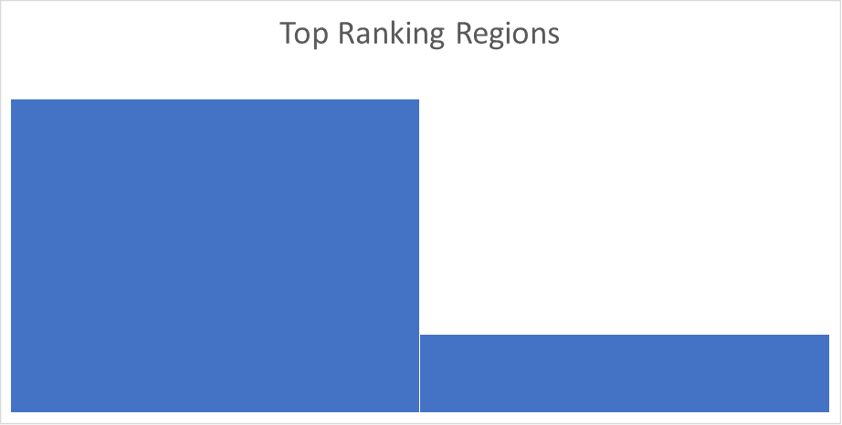
What region rank the highest in overall happiness ?
Northern Europe
Western Europe

Slide 8
Which of the six factors is contributing to a country’s happiness score?
Countries with high GDP per capita, strong Social support and higher Life expectancy tends to be much more happier. There is a strong correlation between these three factors and a Country’s Ranking.

Slide 9
Are any of the six factors correlated?
The factors of GDP per capita, Social support and Life expectancy are strongly correlated

Slide 10
CONCLUSION
The happiest Countries are overwhelmingly located in Northern Europe.
The top ranking Countries are known for their high GDP per capita, strong Social support and high Life expectancy.
Countries should continually fund and seek to improve welfare programs and health care.

